Slide 1

School of information sciences
Bigdata and Data analytics
UNICEF Child Mortality Data Analysis
By,
Pratik CP
Deepak Nayak

Slide 2
Description of Dataset
How it was?
-Structured data
Dividing the dataset
- Under-five
- New born first month of life
- Deaths of children in 1-59 months
- Structured data
Dividing the dataset
- Under-five

Slide 3
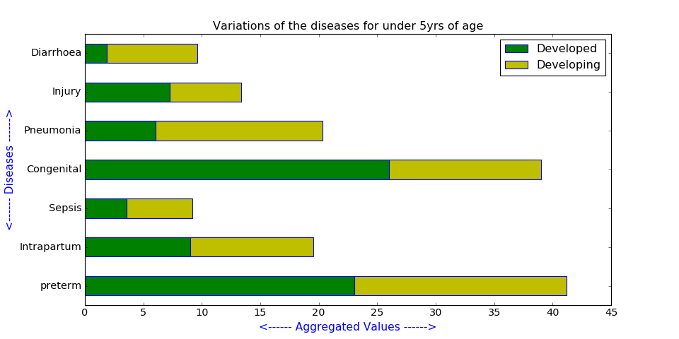
Analysis
How the diseases have effected the developed and developing countries?
- Developed countries
- Developing countries

Slide 4
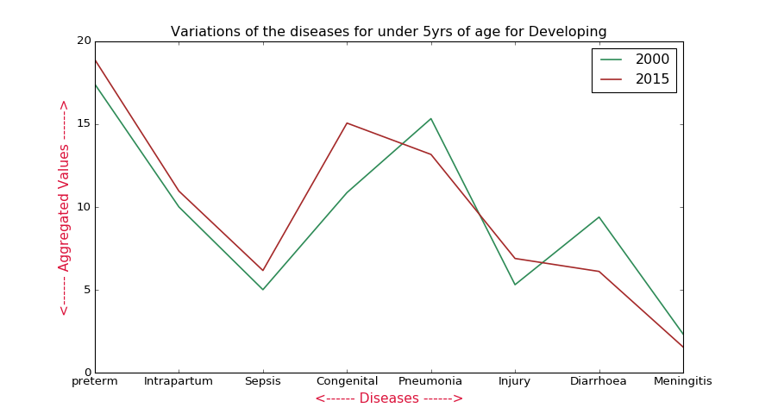
Contd….
Analysing whether the effect of the diseases have reduced as years are passed

Slide 5
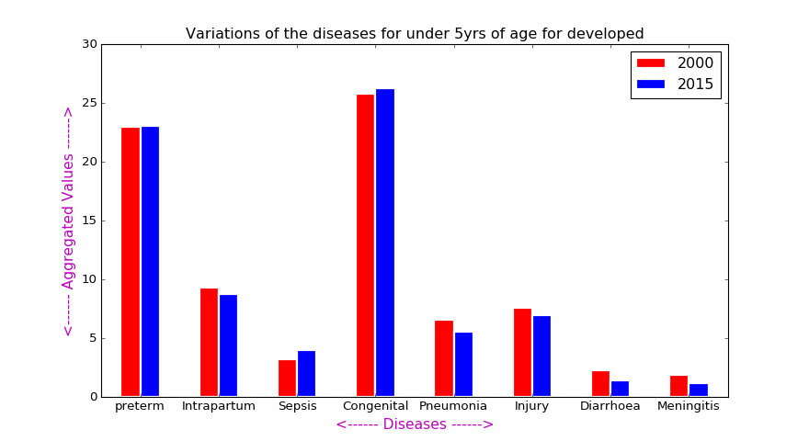
Contd….

Slide 6
Contd...
By the previouse analysis we got some major diseases through which we took top 20 countries
- Which region have been most effected by which diseaese

Slide 7
Further Analysis
Considering countries with highest population and seeing whether there is any improvement in curing those diseases

Slide 8
Thank you
www.github.com/Pratikjain09/term-project1
www.github.com/Deepak3994/term-project1

